Slide 1

Analysis of Television’s Data

Slide 2
About me:
I am Mohammed Azharuddin. Below is my background information:
Background:
MBA specialization in Information Technology.
Currently learning data science at Innomatics Research Labs.
Why Data Science:
Data science involves solving complex problems and driving business growth through valuable insights.
It combines statistics, programming, and domain knowledge to analyze data and extract actionable insights.
Additionally, it supports decision-making and making predictions across various fields based on the data.
Experience:
Tech Mahindra: Managed and resolved customer queries through email and chat support. Provided technical assistance and troubleshooting for various issues. (1 Year)
Genpact: Handled customer support via email and chat, focusing on resolving complex queries. Processed and analyzed customer data to provide tailored solutions and recommendations. Worked closely with cross-functional teams to address client needs and improve service delivery. (1 Year)
LinkedIn & GitHub :
LinkedIn: www.linkedin.com/in/mohammed-azharuddin90
GitHub: https://github.com/mdazharraza90

Slide 3
Business Problem and use case Domain:
Business-Problem: E-commerce Pricing strategy in Consumer Electronics (TVs). An E commerce company want to optimize its Televisions pricing strategy to maximize revenue and stay competitive in the market.
Use case: Analyzing TV pricing, features, and ratings to identify trends and make data-driven decisions for inventory and marketing strategies.
Objective of the Project:
Brand and pricing strategy of televisions, Market trend Identification, analysing the data from the e commerce website through Web Scrapping. This project combines the data collection , preprocessing, web scrapping.
Data – collection: Implementing the web scrapping techniques to collect the data from an e-commerce websites that lists Television prices and specifications. Extract an information such as brand, model, launch year, screen size, display, price etc..
Data – preprocessing : Clean and preprocess the scraped data to ensure consistency and quality. Handle missing values, removing duplicates, and convert data into structural format .
Website:
Flipkart: Flipkart is an Indian e commerce company founded in year 2007. It is an online market where users can purchase a wide range of products including electronics, fashion, home appliances and many more.
Tools Used: Python libraries such as Beautiful Soup, NumPy, Pandas, Seaborn, matplotlib, re
Web Scrapping details: Beautiful soup is a python library for extracting data from the web pages. Parse the HTML or XML content of the webpage using beautiful soup. Navigate the parsed HTML content and extract the data you need. This often involves identifying HTML elements using their classes, tags and attributes.

Slide 4
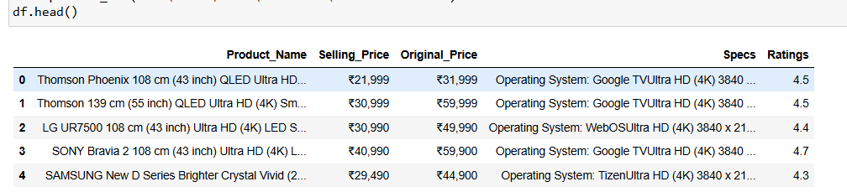
Data Cleaning:
Clean and preprocess the data to ensure consistency and quality. Handle the missing values, remove duplicates and convert the data into a structural format for machine learning.
Data Manipulation:
Data manipulation is the process of changing , cleaning, and organizing the data to make it more suitable for analysis. It involves various operations on the data including filtering, sorting, transforming and combining the data.
Filling NA values
Filling missing values
Dropping necessary columns
Sorting the Data frame
Dropping duplicates
Converting the data into Original data types like, int, float, object

Slide 5
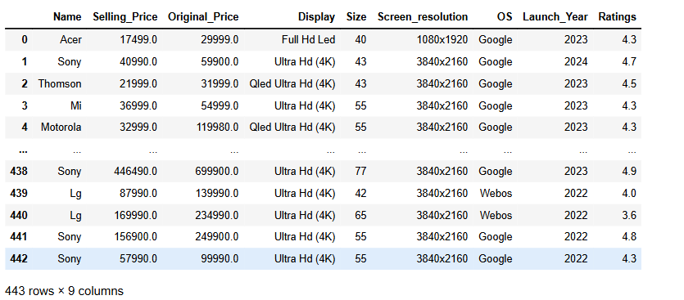
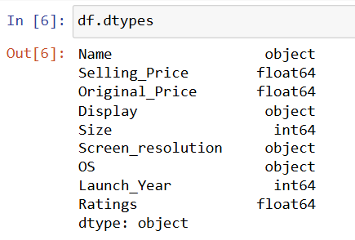
Dataset Overview:
The cleaned data set consists of 443 rows and 9 columns
Shape:
Rows: 443, Cols: 9
Description:
Columns Include Such as Name, Selling Price, Original Price, Display, Size, Screen Resolution, OS, Launch Year, Ratings.
Various data types include float64, int64, and object.

Slide 6
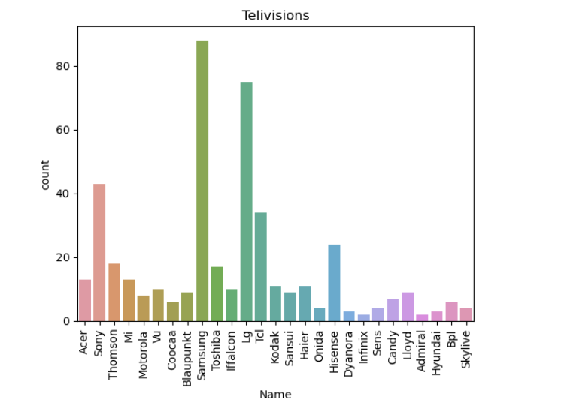
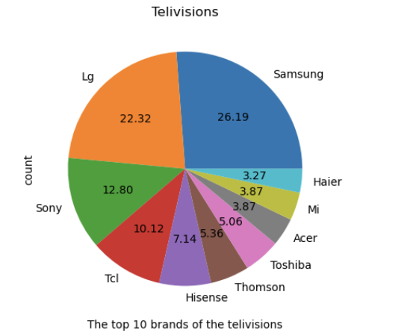
Univariate Analysis – Top 10 Brands
The Graph 1 represents the bar plot of total number of television’s are present in the market and which brand has more number of products.
The Graph 2 represents the pie plot where it shows the top 10 brands among the total number of televisions.
The bar plot and pie plot visually represent the Distribution of the data brand wise. This analysis helps us to understand Samsung and LG has more number of products compared to other brands.

Slide 7
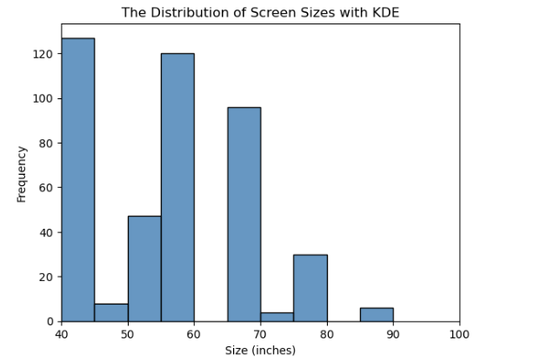
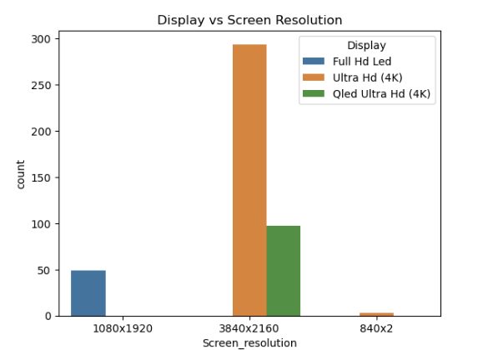
From the above hist plot we can see that the most preferred sizes are 43 inches, 55 inches and 65 inches .
There are some more sizes available in the market like 50 inches and 75 inches as per the people requirement
From the above bar plot of the screen resolutions are 3840x2160 (Ultra HD 4K) seems to be in greater demand as more than 70% products are these types
People also prefer 3840x2160 (QLED Ultra HD (4k)

Slide 8
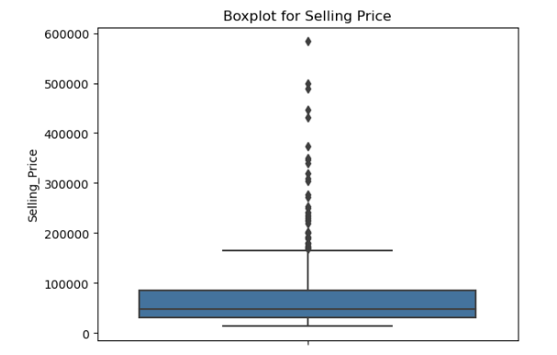
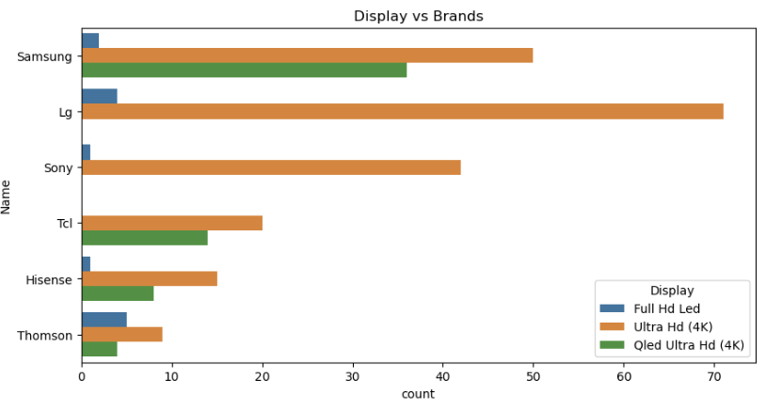
Box plot Represents the interquartile range (IQR) between the 25th (Q1) and 75th percentiles (Q3).
Line inside the boxplot indicates the median (50) percentile of the selling price. Points outside the whiskers are considered outliers and are plotted as individual dots.
BI Variate Analysis
In this bar plot we can see that Samsung offers products in all types of screen quality. Where LG and Sony does not offer QLED Ultra HD (4k). The competitive brands like TCL, Hisense, Thomson also offers all types of screen qualities in less number of count.

Slide 9
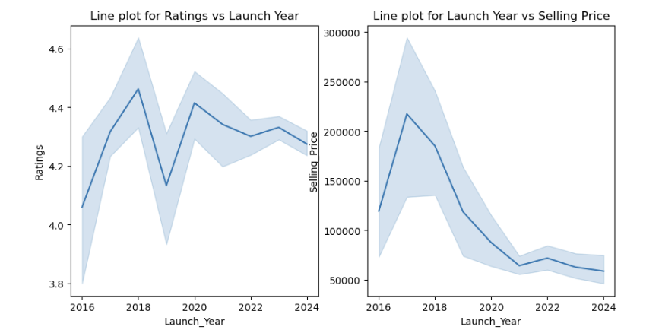
From the above line plots we can see the ratings are being fluctuated year wise. Rating might be goes up and down. Upward trend indicates improving ratings, while a downward trend indicates declining ratings.
From another line plot we can able to see the average selling prices of the products are decreasing. This visualization provides a clear view of how the average selling price of products has changed over time, helping you analyze trends in pricing strategies or market conditions.

Slide 10
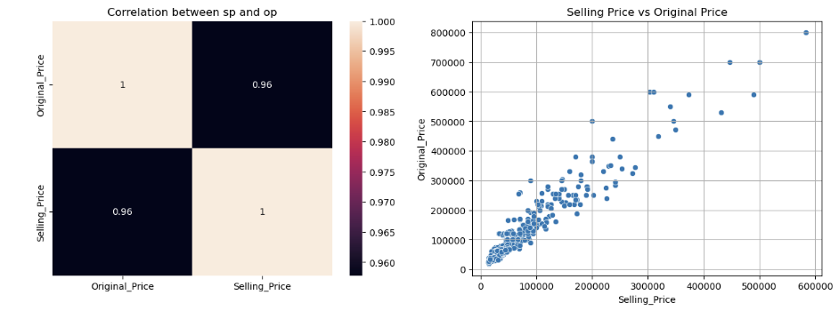
From the heatmap graph the correlation value between selling price and original price is 0.96.
The scatter plot helps us to visualize the relationship between these two variables and detect any patterns or outliers. If the Original price increases then the selling price tends to increase.

Slide 11
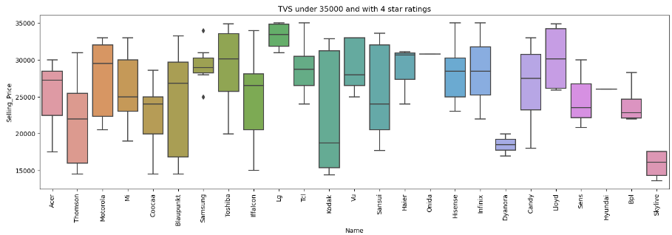
This box plot shows the tv’s under 35000 with above 4 star ratings. We can see the buy the tv’s from brands like Thomson, Motorola, Coocaa, Kodak, Blaupunkt, Iffalcon, etc.. at very affordable price. Where Sony is the only brand where we cannot get tv under 35000.

Slide 12
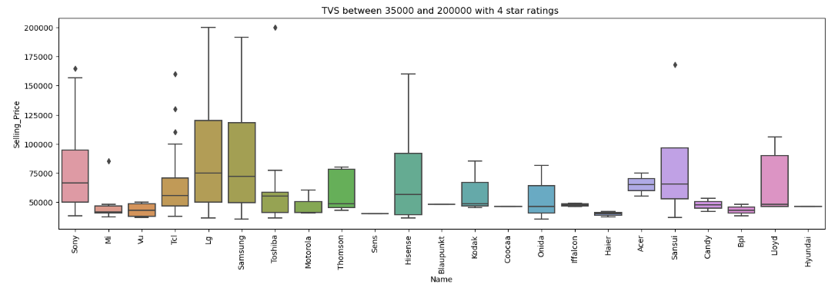
From the above box plot we can see most expensive tv’s are from Samsung, LG, Sony. This products has more cost in the market. Meanwhile TCL, Toshiba, Thomson, Hisense, Onida, Sansui, Lloyd are the affordable tv’s within the budget.

Slide 13
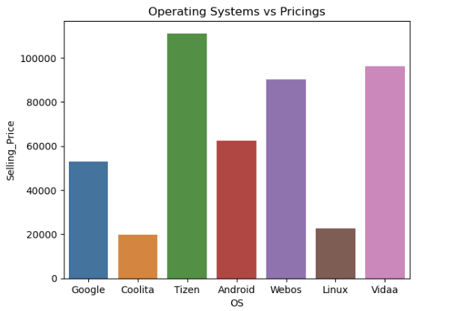
The Tizen OS and WebOS cost more which comes under Samsung and LG products which has more features of connectivity and security they are very fast compared to other Operating Systems. That makes tv’s cost more.
The Google OS, Vida OS and Android OS comes with decent features which offer’s minimum features with respect to average cost.
Linux OS and Coolita OS are the cheapest and most affordable Operating systems

Slide 14
Key Business Questions:
This EDA will answer some interesting questions like:
Demand for different types of televisions and Number of Brands available in the market?
Ans. There are 27 Unique brands available in the market
2. Which are the top 5 brands for television?
Ans. Samsung, LG, Sony, TCL, and Hisense.
3. Which brand has the highest number of products i.e. television ?
Ans. Samsung has Highest number of televisions in all sizes and all display types
4. Why Samsung, LG, Sony sell their TVs at high price?
Ans. This brands offers good display qualities and latest Operating systems which makes TVs more expensive
Which brand has average selling price by brand?
Ans. Thomson, Coocaa, Kodak, Blaupunk, Iffalcon

Slide 15
Conclusion:
The TV market is diverse with 27 brands, featuring popular brands like Samsung, LG, and Sony, while competitive brands like TCL, Thomson, Hisense, Motorola, Iffalcon, MI and Toshiba offer balanced cost and quality.
Samsung dominates with the widest range of products and sizes, while preferred screen sizes are 43, 50, 55, and 65 inches, with resolutions up to 3840x2160 Ultra HD (4k) display. 3840x2160 Ultra HD (4K) resolution is increasingly popular among consumers. This resolution is favored for its high-quality display and superior viewing experience.
A positive correlation exists between original and selling prices, with higher-priced TVs generally sold closer to their original prices. Brands like TCL, Hisense, Toshiba, MI, and Thomson offer average selling prices with good quality.
Samsung, LG, and Sony command higher prices due to their advanced operating systems (Tizen, webOS, Android TV) and superior quality. These brands offer the latest features and connectivity options, justifying their premium pricing.

Slide 16
Experience:
Data collection
Web Scrapping skills
Exploratory Data Analysis
Meaningful conclusion from the data
Challenges:
Data Quality Issues
Data Cleaning
Time consumption
Missing values
Unstructured Data

Slide 17

THANK YOU

